Slide 1


Understanding and Using Ruble Government Bond Futures
MOSCOW EXCHANGE SEMINAR
Date: 19 June 2013
Venue: Moscow Exchange
Speakers:
Micex: Vadim Zakroyschikov
Bloomberg: Timothy Murphy

Slide 2
Seminar Objectives
Promote the understanding of Government Bond Futures
Increase usage and liquidity of Ruble Government Bond Futures
Improve pricing efficiency across Government and Corporate Bond and Futures Markets
Highlight potential trade ideas
Help pre-trade analysis and hedge design
Assist in the development of Risk Management approaches

Slide 3
Topics (I)
Understanding Government Bond Futures
Types of Contracts
Contract specifications
Volume and Open Interest
Pricing Government Bond Futures
Defined deliverable Bond Baskets
Understanding, calculating and using conversion factors
Understanding Futures Basis and Cheapest to Deliver (CTD)
Implied Repo and changes in CTD
Monitoring historical evolution of Basis and Implied Repo rates
Valuing Serial Futures contracts’ spreads.

Slide 4
Topics (II)
Hedging Bonds using Government Bond Futures
Pre-Trade Analysis
Understanding Bloomberg Futures Risk and Yield Calculations
Hedging Ratios
Butterfly Hedge, Barbell Hedge
Trade Monitor
Working with Bloomberg’s Excel API in Real-Time
Multi Asset Risk System (MARS) for Bonds and Futures
Calculating Historical Futures Price Volatility

Slide 5
FUNCTIONALITY PRESENTATION
Understanding and Using Ruble Government Bond Futures
Date: 19 June 2013
Venue: Moscow Exchange

Slide 6
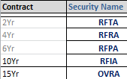
Contract Codes

Slide 7
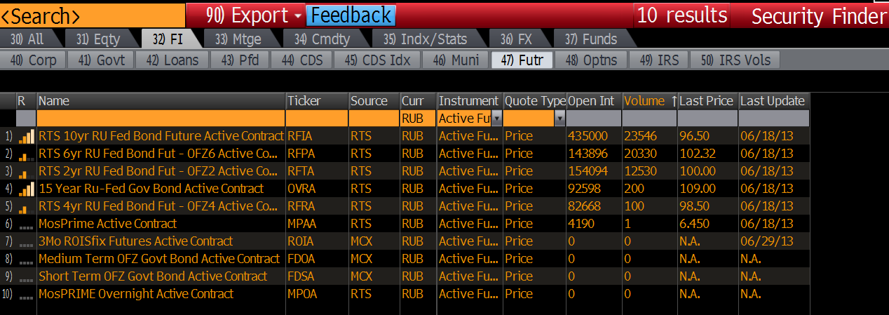
Discoverability->SECF<GO>
Alternatively:
CEM <GO>
“Show” = “Categories”
Select Financial Contracts -> “BOND”
Under “Description” enter “RU” to filter

Slide 8
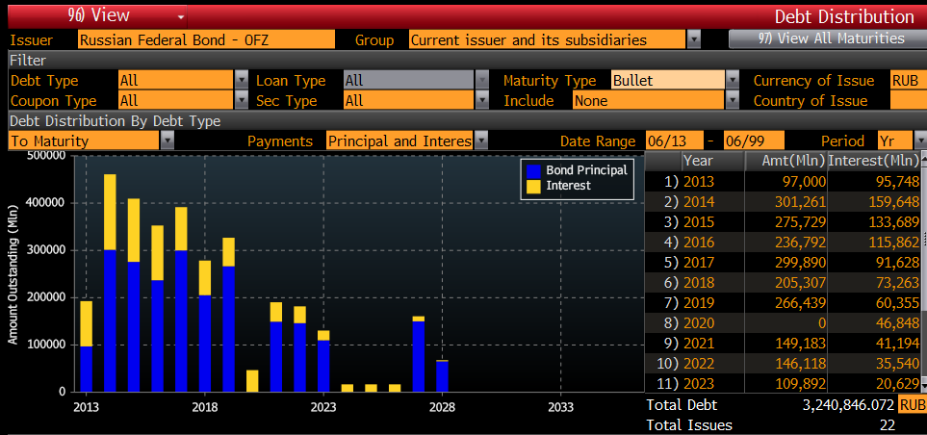
Debt Distribution DDIS<GO>
Load a Ruble Government Bond and run the Debt Distribution function DDIS <GO> to view market supply concentration
The above screen is for Bullet maturities, choose from Maturity Type All , Bullets or Sinkable

Slide 9
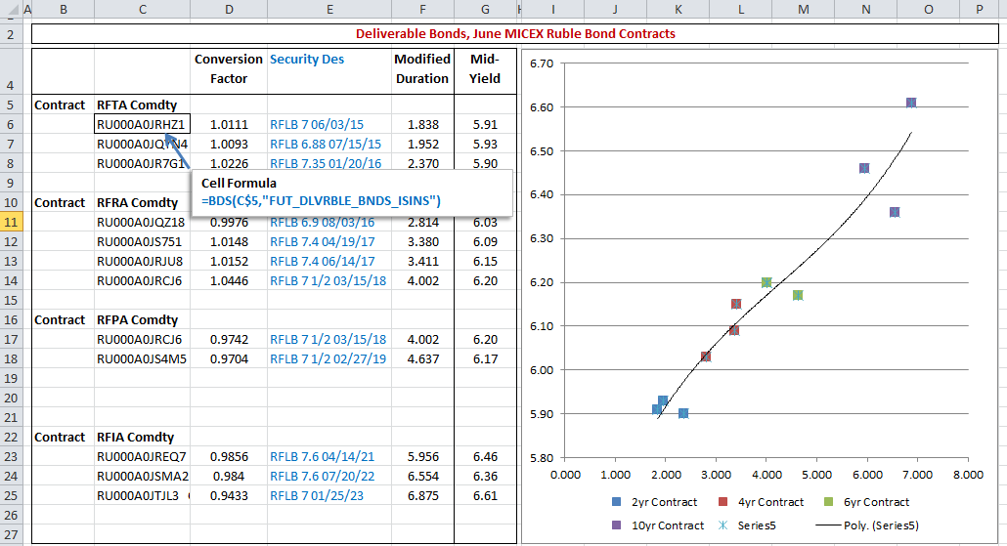
Viewing Deliverables in Excel

Slide 10
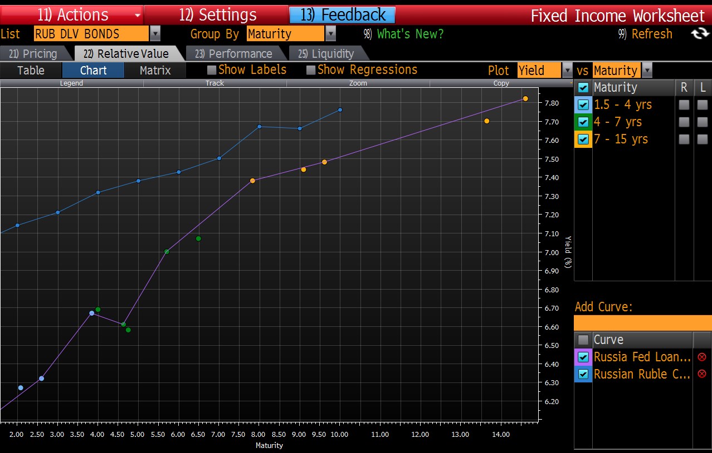
Viewing Deliverables in FIW<GO>
Create, Save and load a dynamic list using :
SRCH NEW <GO>

Slide 11
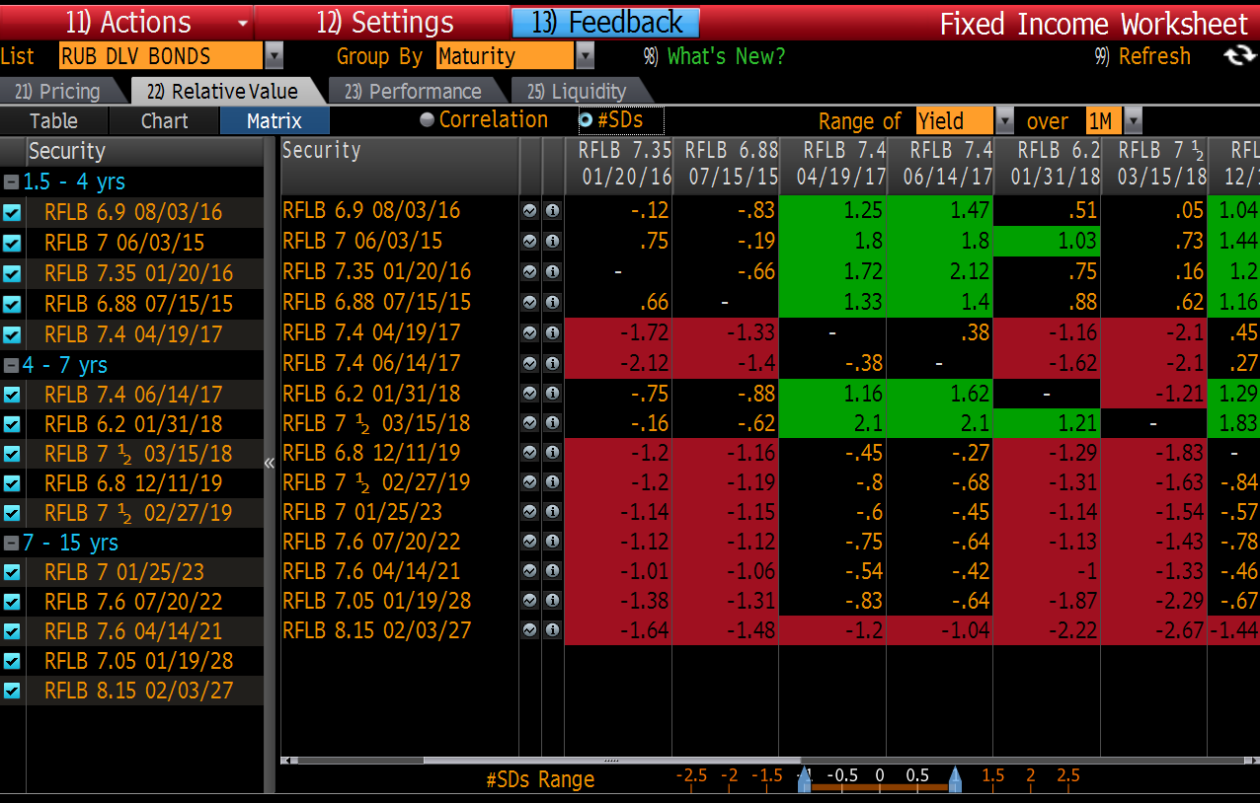
Viewing Deliverables in FIW<GO>
View Correlations and Relative Standard Deviations across Deliverable Bonds using FIW<GO>

Slide 12
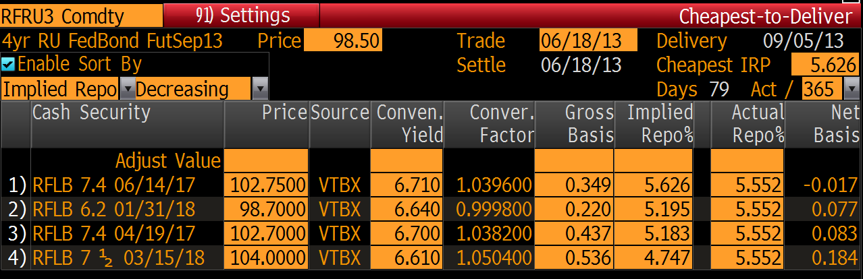
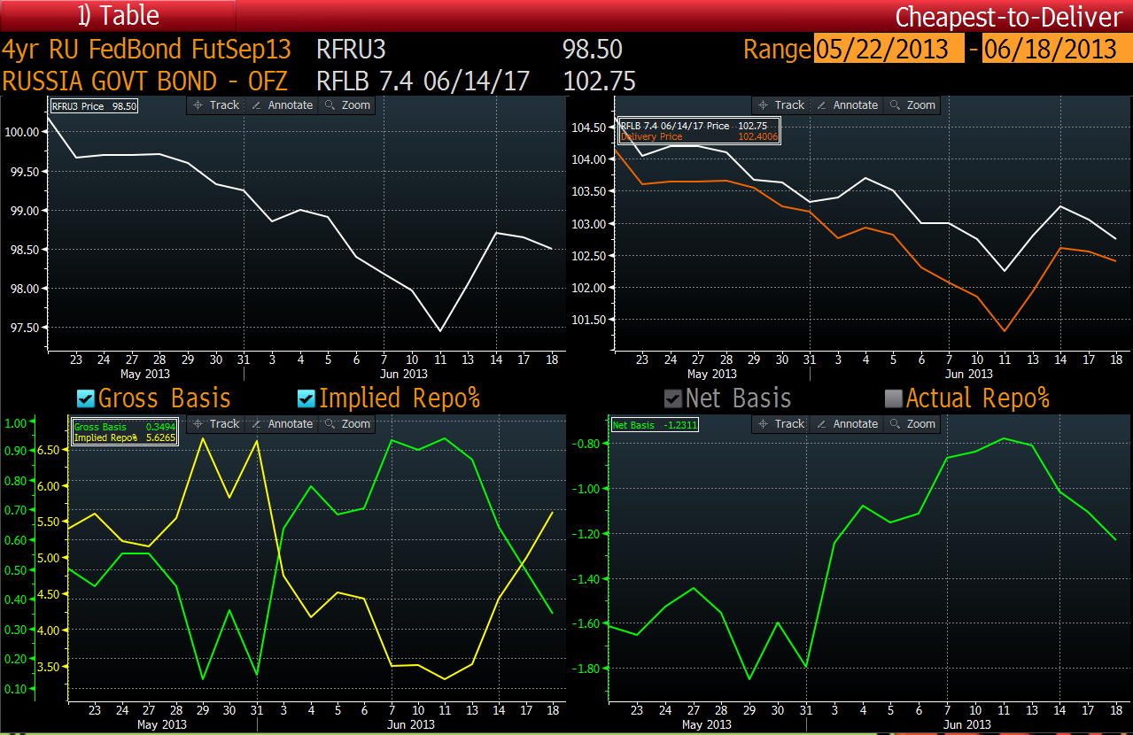
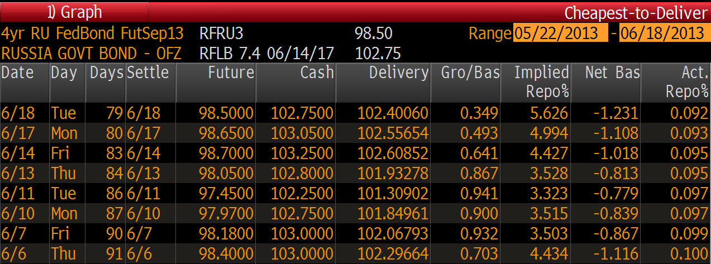
Cheapest to Deliver Monitor

Slide 13
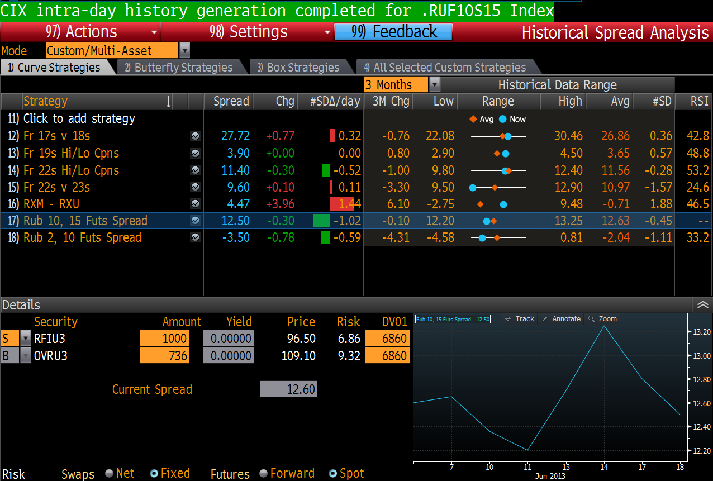
Viewing Fut. Curve Spreads in HSA<GO>

Slide 14
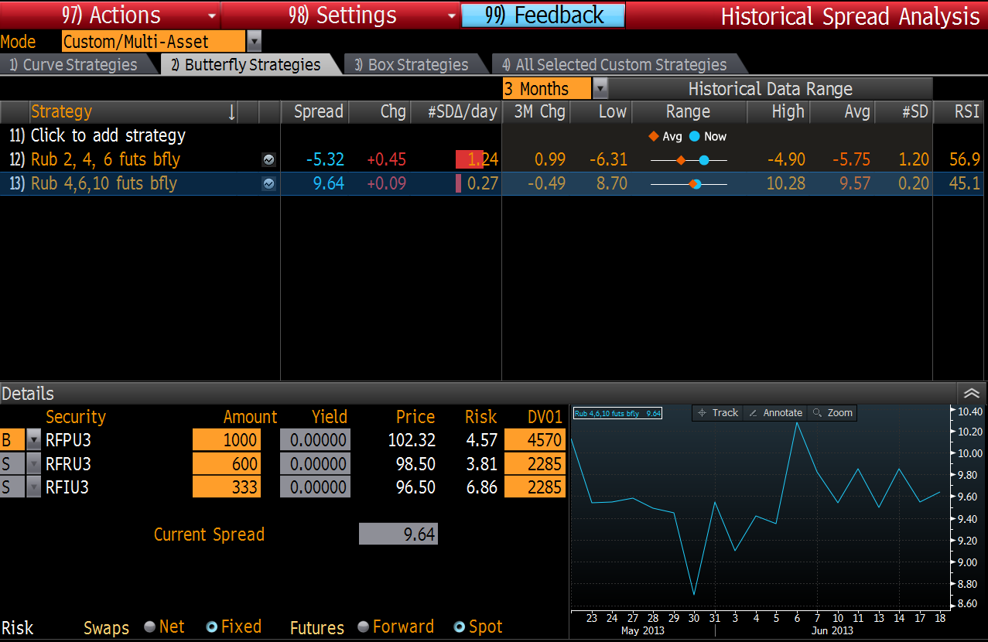
Viewing Futures Butterflies in HSA<GO>

Slide 15
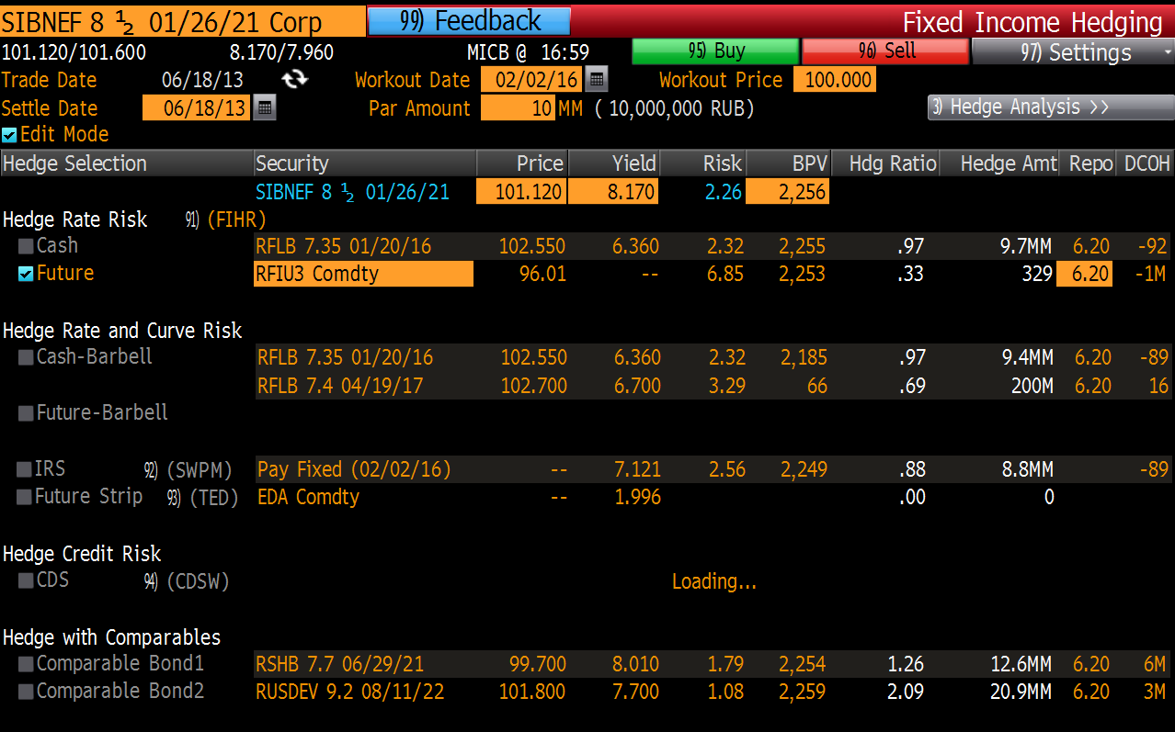
Evaluating Hedge Selection FIHG<GO>

Slide 16
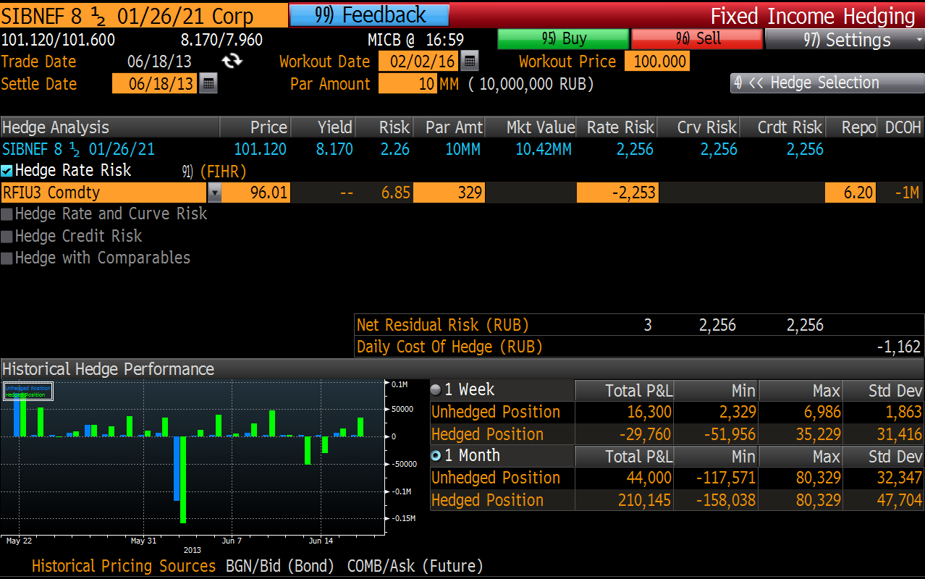
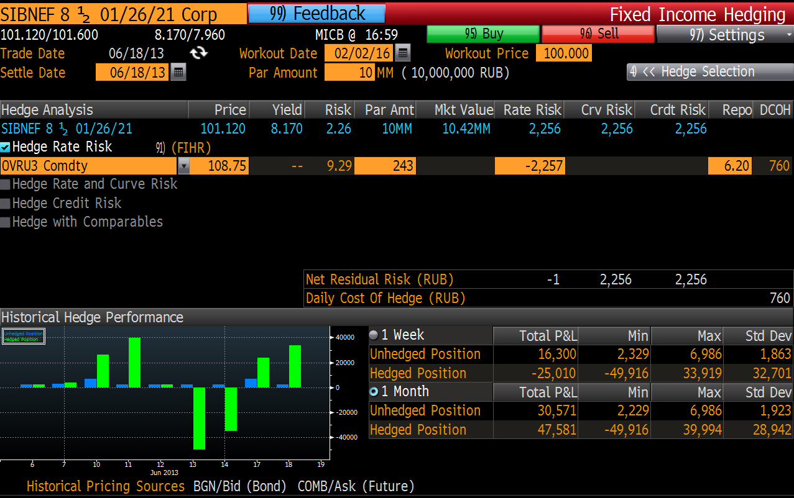
Comparing Hedge Selection FIHG<GO>

Slide 17
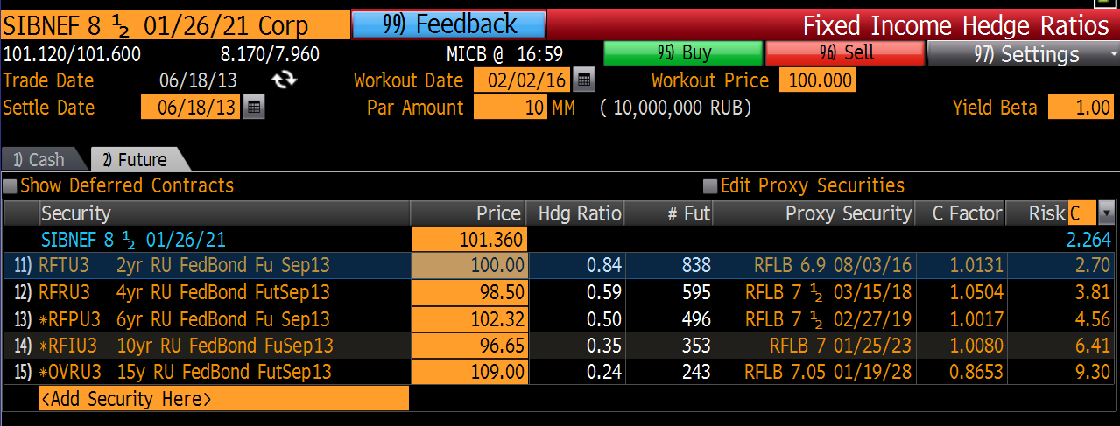
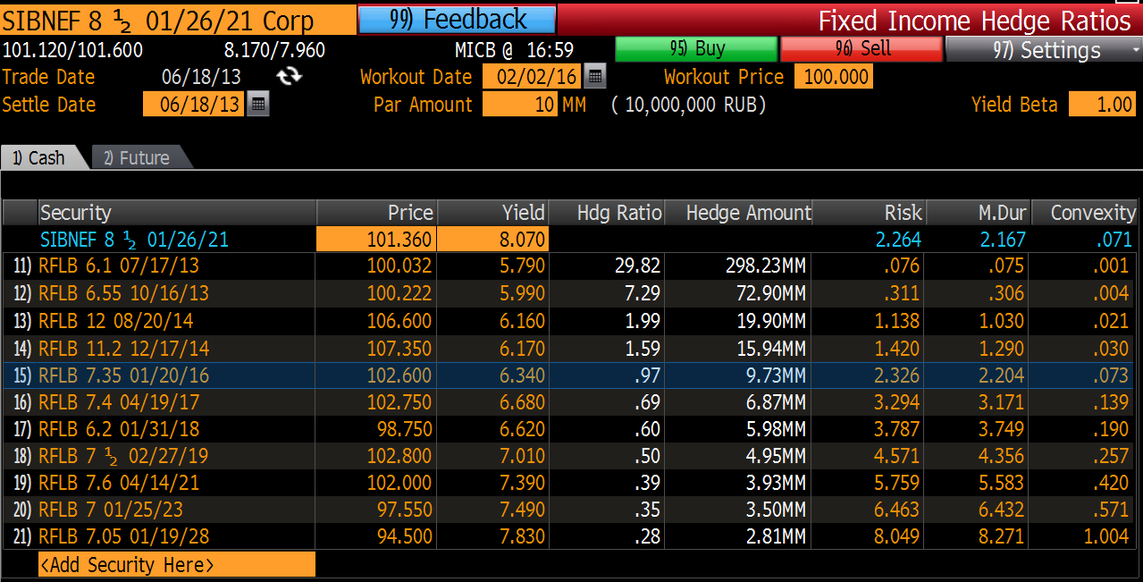
Viewing Cash and Futures Hedge Ratios

Slide 18
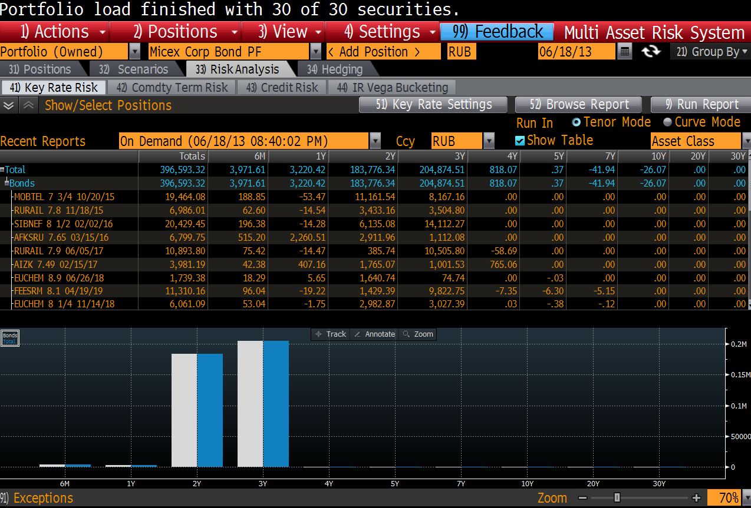
Portfolio Hedging- MARS <GO>
Load Corporate Bond Portfolio plus any IRS positions into MARS <GO>
Run Key Rate Risk Analysis Report

Slide 19
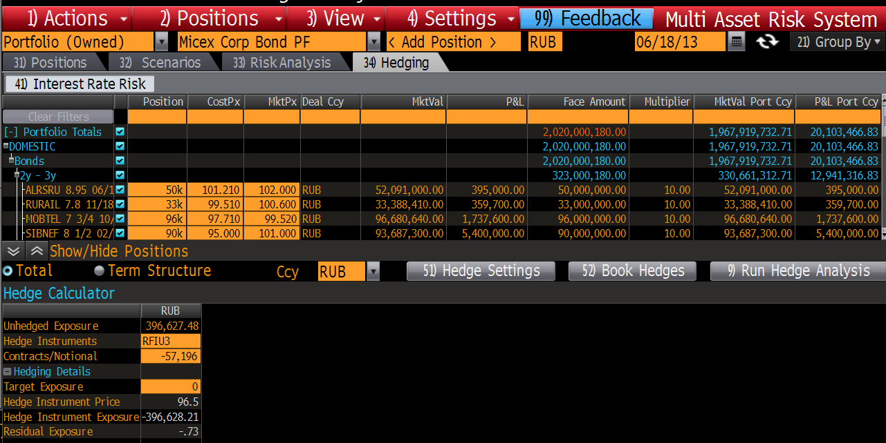
Portfolio Hedging- MARS <GO>
Total Portfolio Nominal = Rub 2,020 million
This has a BPV 01 Rub 396,627
If we choose the 10 year contract as our hedging vehicle, we calculate -57,196 Contracts
Change the Futures Contract in the “Hedge Settings” tab

Slide 20
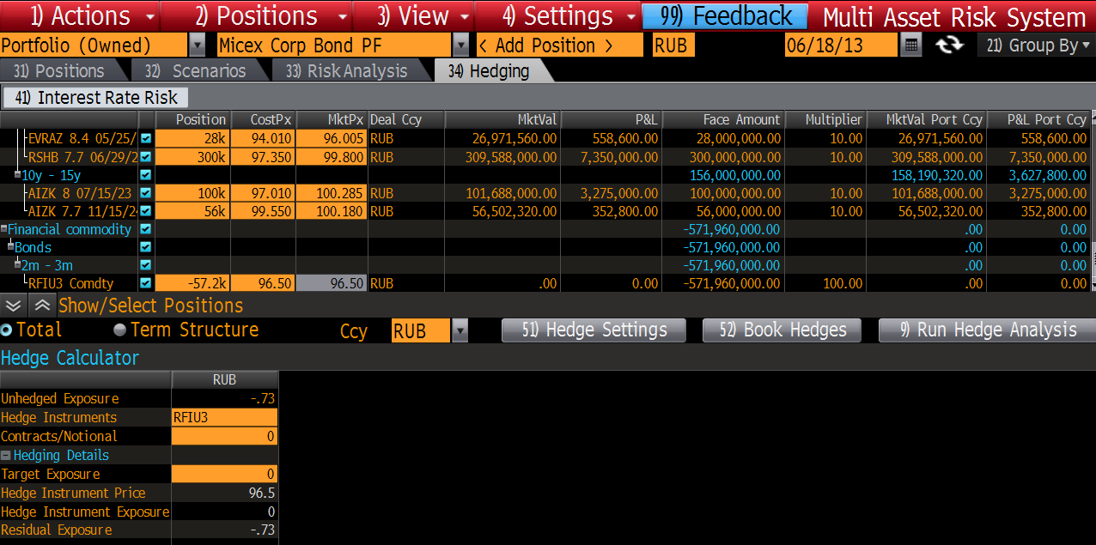
Portfolio Hedging- MARS <GO>
If we enter the hedge position and re-run the Hedge Analysis, our exposure goes to zero

Slide 21
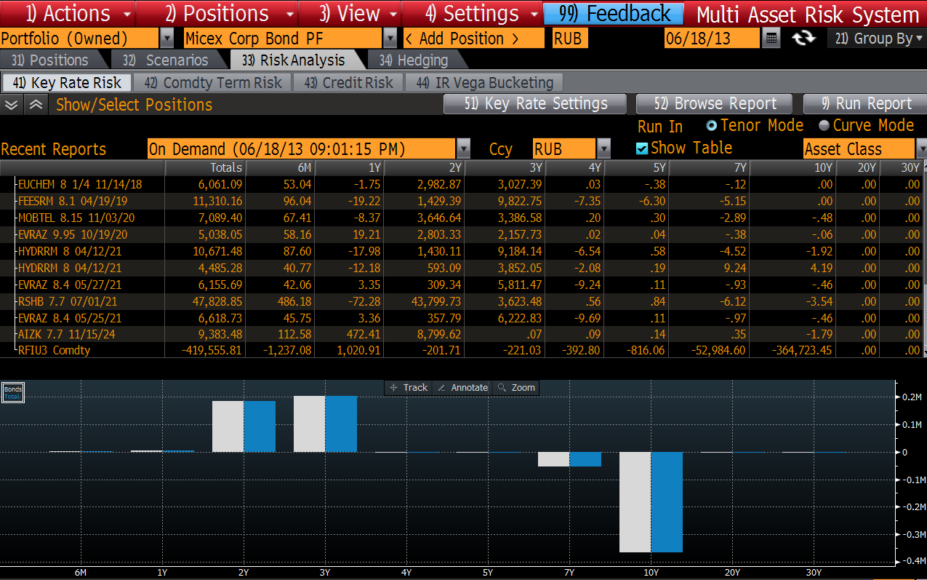
Portfolio Hedging- MARS <GO>
And if we now run a Key Rate Risk Analysis, we can see the overall shape of our portfolio exposures..
ie Curve Steepening

Slide 22
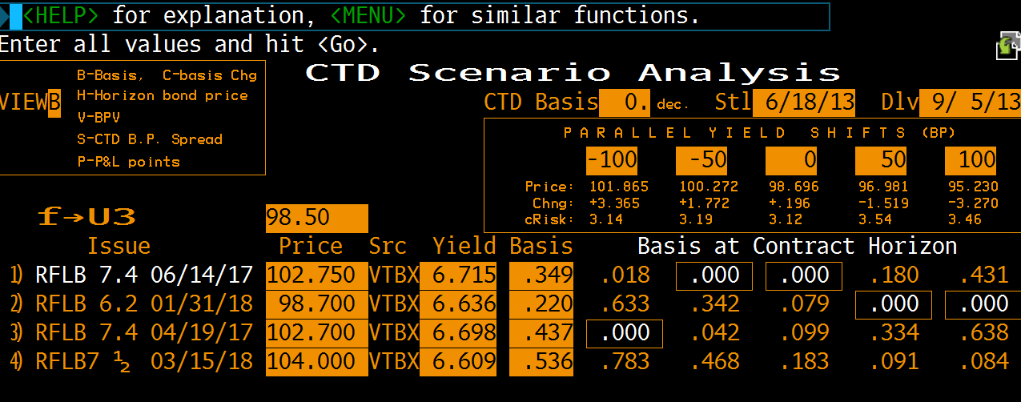
Calculating Changes in CTD <GO>
For Delivery on 5th September
With the CTD basis converged at zero
See how the cheapest to deliver bond changes (ceteris paribus)

Slide 23
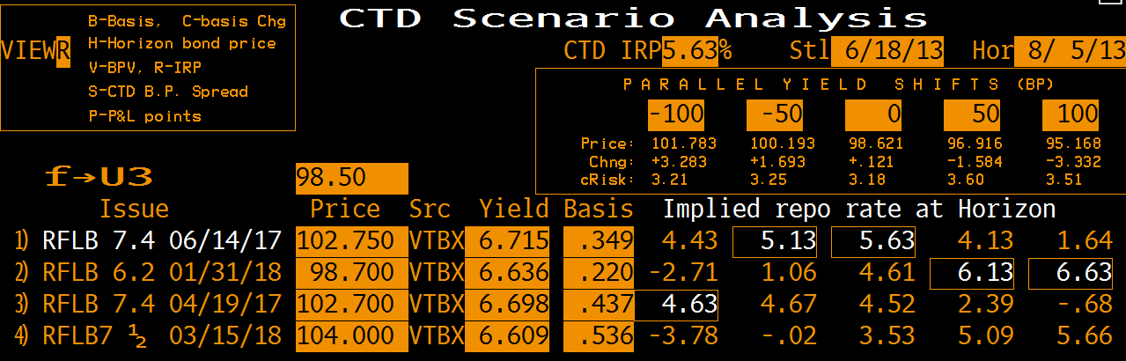
Calculating Changes in CTD: Use CMS <GO>
For Delivery on 5th September with the CTD basis converged at zero
See how the cheapest to deliver bond changes (ceteris paribus)
Note that we can change the horizon to a date before delivery

Slide 24
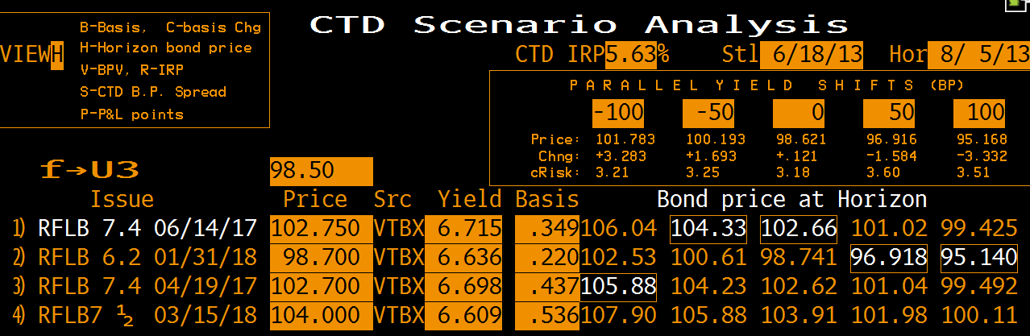
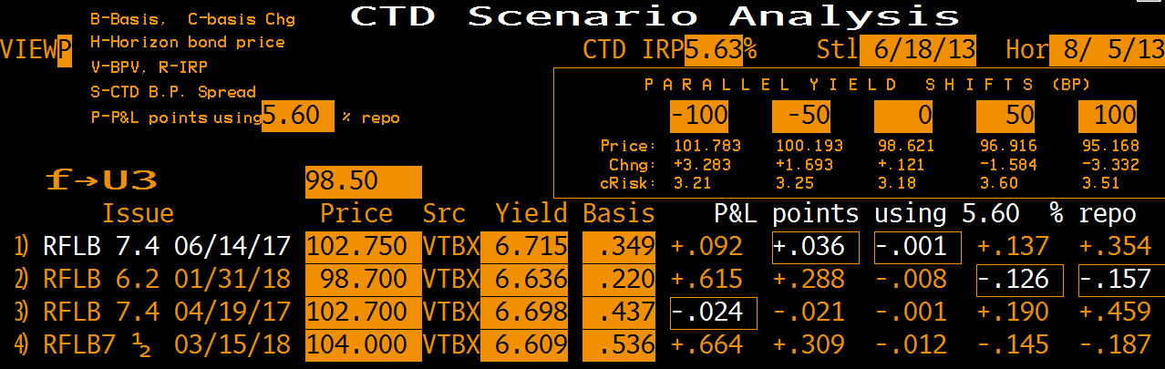
Calculating Changes in CTD: Use CMS <GO>
Note that here we can see the bond prices at our horizon date, under different yield changes
And here we can see the P&L points of being long cash, short futures, financing at the IRP under yield changes

Slide 25
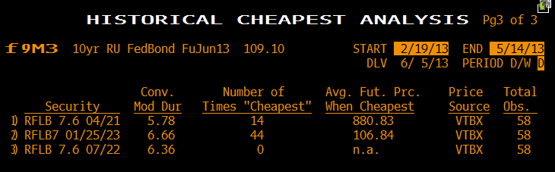
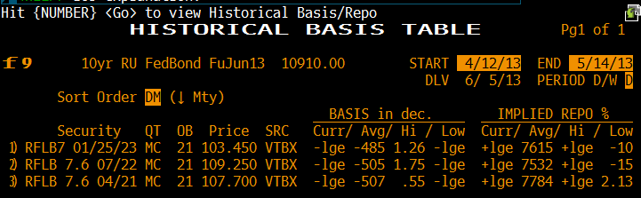
HCA <GO>
HBT <GO>

Slide 26
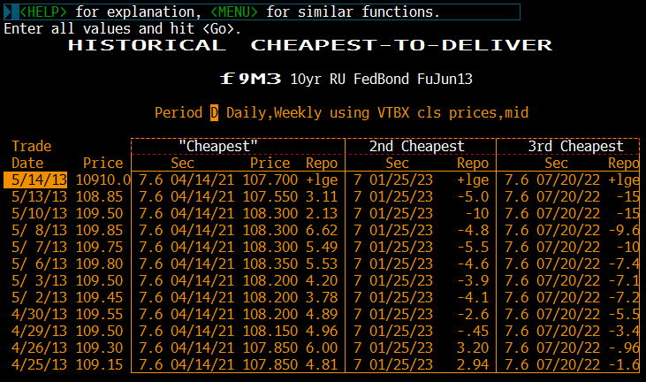
HCD <GO>

Slide 27
Understanding and Using Ruble Government Bond Futures
MOSCOW EXCHANGE SEMINAR
Date: xx June 2013
Venue: Moscow Exchange
For more information please contact:
Vadim Zakroyschikov at MICEX
Timothy Murphy at Bloomberg

